Slide 1
Stanford ME469: Common low-Mach Discretization Approaches
Stefan P. Domino
Computational Thermal and Fluid Mechanics
Sandia National Laboratories SAND2018-4536 PE

Slide 2
Common low-Mach Discretization Approaches: Outline
The Concept of Meshing
Why Unstructured?
Unstructured Element Typoes
Finite Element Method (FEM)
Control-Volume Finite Element Method (CVFEM)
Edge-based Vertex-Centered (EBVC)
Cell-centered Finite Volume (FV)
Staggered arrangement
Conclusions

Slide 3
Introducing a Mesh over Heart Domain, Ω
Notes: Geometry is:
Complex
Curved
Sharp

Slide 4
Introducing a [Finite Difference] Mesh over Heart Domain, Ω
? What breaks..
Notes: Geometry is:
Complex
Curved
Sharp

Slide 5
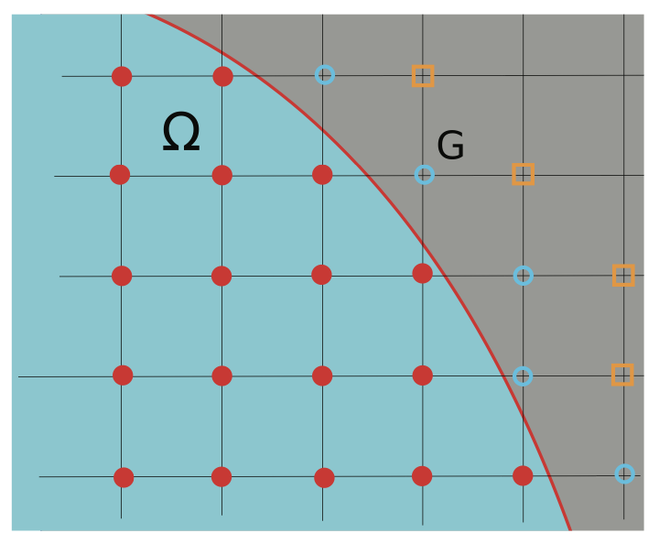
Introducing a [Finite Difference] Mesh over Heart Domain, Ω
? What breaks..
Notes: Geometry is:
Complex
Curved
Sharp
Not impossible: Chertock, et al., “A Second-Order Finite-Difference Method for Compressible Fluids in Domains with Moving Boundaries”, Commun. Comput. Phys., 2018

Slide 6
Introducing a [Structured Mesh] over Heart Domain, Ω;
Notes: Geometry is:
Complex
Curved
Sharp

Slide 7
Introducing a [Structured Mesh] over Heart Domain, Ω;
? What breaks..
Notes: Geometry is:
Complex
Curved
Sharp

Slide 8
Introducing a [Structured Mesh] over Heart Domain, Ω;
? What breaks..
Notes: Geometry is:
Complex
Curved
Sharp

Slide 9
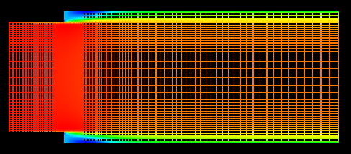
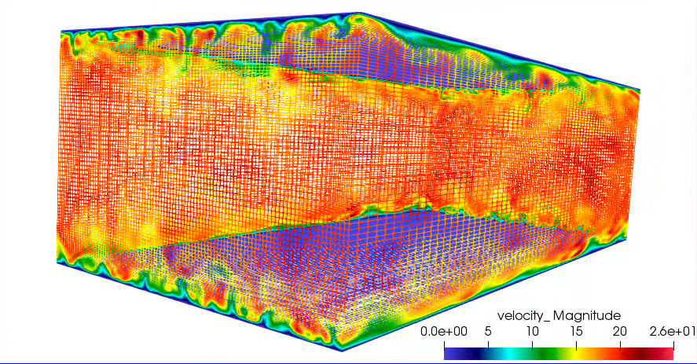
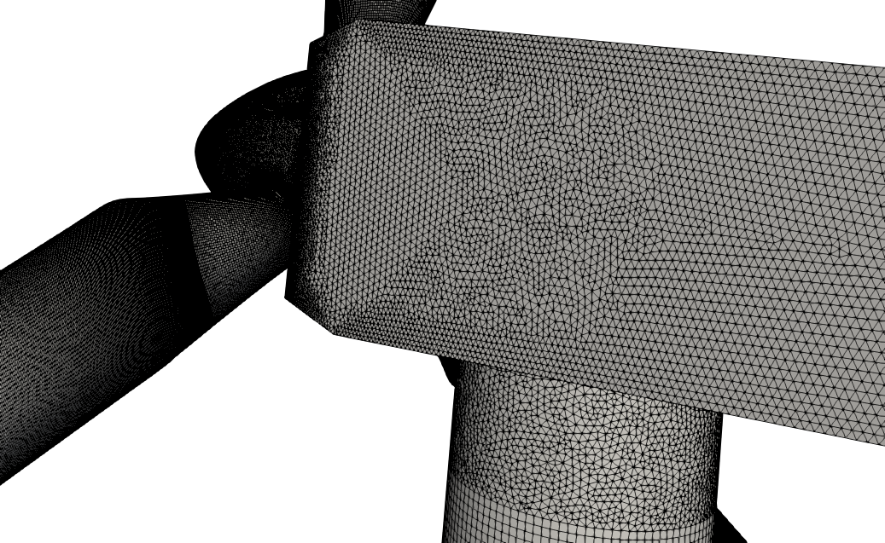
Structured vs Unstructured
Many times, the canonical flows of interest are in simplified geometries that allow for cartesian meshes – with “stair-stepping”
RANS-based backward facing step (Domino, 2012)
Re^{τ} 395 plane-channel (Jofre, Domino, Iaccarino, 2018)
Often times, not!
https://www.itascainternational.com/software/introduction-to-meshing

Slide 10
In Fairness…. The Carbon-Capture Multidisciplinary Simulation Center
15MW coal-fired boiler volume rendered image of large (90 μm) particles
Staggered schemes have been demonstrated to support complex applications
Cut-cells and embedded approaches help
http://ccmsc.utah.edu/about.html

Slide 11
Introducing a Mesh over Heart Domain, Ω
Elements of size 4 (Quad4) or 3 (Tri3) have been introduced
Exterior domain is faceted
Non-conformal interface between the Tri3 and Quad4 block
Two types of connectivity have been presented: node:element and element:face:element
Two types of integration: Ω^{e} vs Ω^{cv}

Slide 12
Introducing a Mesh over Heart Domain, Ω
Elements of size 4 (Quad4) or 3 (Tri3) have been introduced
Exterior domain is faceted
Non-conformal interface between the Tri3 and Quad4 block
Two types of connectivity have been presented: node:element and element:face:element
Two types of integration: Ω^{e} vs Ω^{cv}

Slide 13
Data Structure Ramifications
A bit more complicated….
Element and associated data structures are indexed directly via i^{th} and j^{th} location, e.g., velocity_x(i,j), over the range: velocity_x(0:nX,0:nY)
Neighbors are directly indexed, e.g,, “north” neighbor of (i,j) is (i,j+1)
Element and associated data structures are indexed indirectly via a data structure, e.g., velocity_x(k), ober the range: velocity_x(0:nElem)
Neighbors of (k) are obtained via a relationship mapping obtained, e.g.,
std::vector<int> neighbor_elems
= elem_relationship(k);

Slide 14
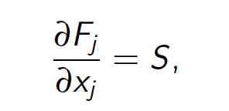
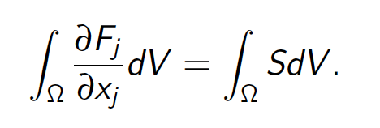
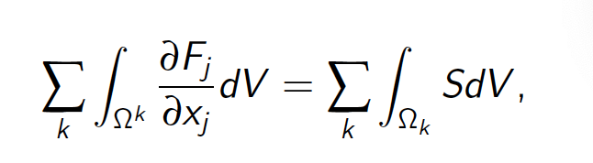
Integration Over the Domain
Consider a simple model equation with the heart domain in mind:
Integrating over the domain, Ω:
Without loss of generality, let us define a set of subdomains, Ω_{k}:
Where F_{j} is a flux and S is a source term
Note: Often the formality of Σ_{k} and Ω_{k} is dropped and is implied over the integration

Slide 15
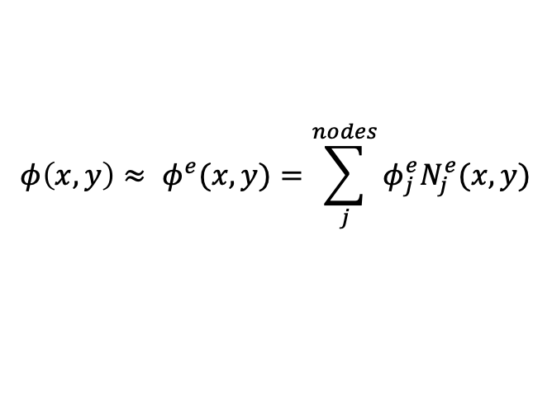
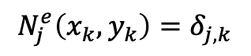
Mesh-based Methods Basic Concept: Sub-divide domain into Finite Elements and Numerically Integrate
$$φ\left(x,y\right)≈ φ^{e}(x,y)=\sum_{j}^{nodes}{φ_{j}^{e}N_{j}^{e}(x,y)}$$
Define basis within the domain:
While restricting to a Lagrange nodal basis,
$$N_{j}^{e}\left(x_{k},y_{k}\right)=δ_{j,k}$$

Slide 16
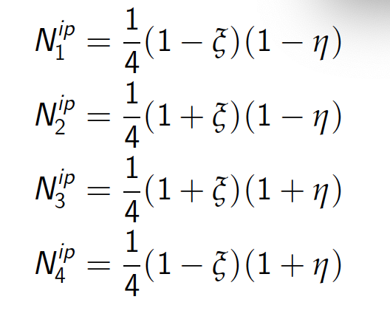
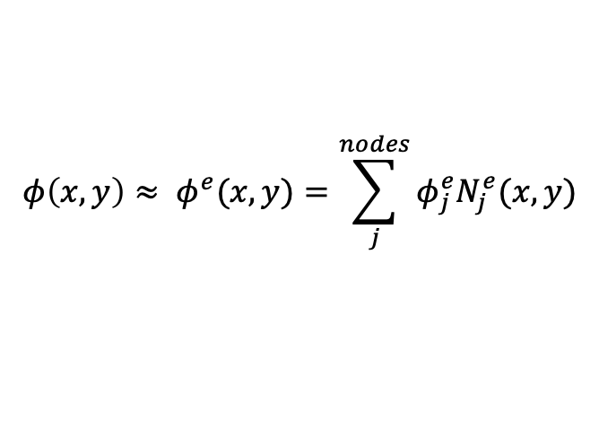
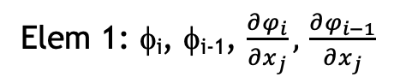
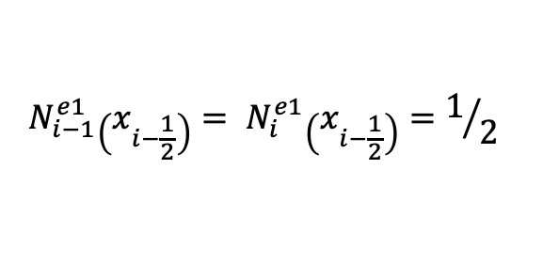
Re-visiting the Underlying Basis: Vertex-centered
Mindset change for unstructured: the mesh connectivity we have implicitly defines the limiting spatial order of the scheme, here in an unstructured setting, second-order in space
The “left”/”right” two-state scheme where i-2, and i+1 values are “reachable” through extrapolation
Later, in the advection stabilization set of lectures, we will see that such extrapolation is, often “limited”
i-2
i-1
_{i-1/2}
i
_{i+1/2}
i+1
i+2
Elem 1: φ_{i}, φ_{i-1}, $\frac{∂φ_{i}}{∂x_{j}},$ $\frac{∂φ_{i−1}}{∂x_{j}}$
Integration points
Degree-of-freedom (DOF)
$$φ\left(x,y\right)≈ φ^{e}(x,y)=\sum_{j}^{nodes}{φ_{j}^{e}N_{j}^{e}(x,y)}$$
$$N_{i−1}^{e1}\left(x_{i−\frac{1}{2}}\right)= N_{i}^{e1}\left(x_{i−\frac{1}{2}}\right)=1/2$$
Iso-parametric coordinate system: -1:+1

Slide 17
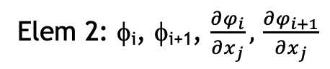
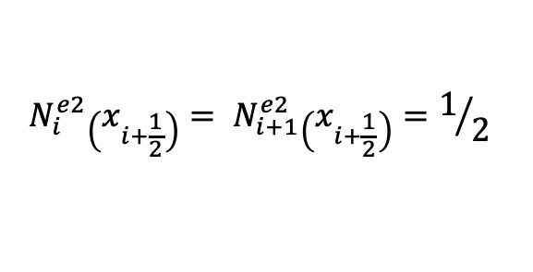
Re-visiting the Underlying Basis: Vertex-centered
Mindset change for unstructured: the mesh connectivity we have implicitly defines the limiting spatial order of the scheme, here in an unstructured setting, second-order in space
The “left”/”right” two-state scheme where i-1, and i+2 values are “reachable” through extrapolation
Later, in the advection stabilization set of lectures, we will see that such extrapolation is, often “limited”
i-2
i-1
_{i-1/2}
i
_{i+1/2}
i+1
i+2
Elem 2: φ_{i}, φ_{i+1}, $\frac{∂φ_{i}}{∂x_{j}},$ $\frac{∂φ_{i+1}}{∂x_{j}}$
Integration points
Degree-of-freedom (DOF)
$$φ\left(x,y\right)≈ φ^{e}(x,y)=\sum_{j}^{nodes}{φ_{j}^{e}N_{j}^{e}(x,y)}$$
$$N_{i}^{e2}\left(x_{i+\frac{1}{2}}\right)= N_{i+1}^{e2}\left(x_{i+\frac{1}{2}}\right)=1/2$$
Iso-parametric coordinate system: -1:+1

Slide 18
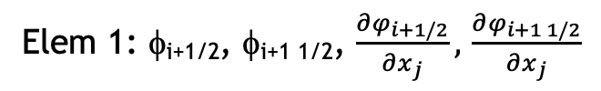
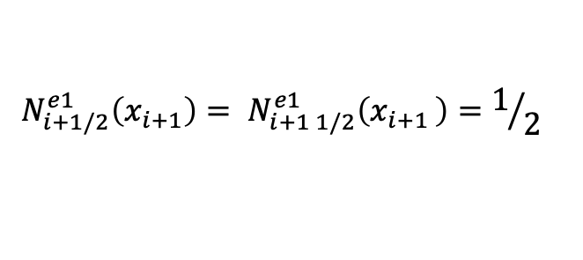
Re-visiting the Underlying Basis: Cell-centered
Mindset change for unstructured: the mesh connectivity we have implicitly defines the limiting spatial order of the scheme, here in an unstructured setting, second-order in space
The “left”/”right” two-state scheme; increased stencil “reachable” - still by extrapolation
Iterate virtual edges of control volume faces, connected to the left and right DOF location
Integration point area vector, or at the face of the elements
What might be a path forward to increase order of accuracy, while maintaining a compact stencil?
Cell-centered
i-2
i-1
_{i-1/2}
i
_{i+1/2}
i+1
i+2
Elem 1: φ_{i+1/2}, φ_{i+1 1/2}, $\frac{∂φ_{i+1/2}}{∂x_{j}},$ $\frac{∂φ_{i+1 1/2}}{∂x_{j}}$
Integration points
Degree-of-freedom (DOF)
$$φ\left(x,y\right)≈ φ^{e}(x,y)=\sum_{j}^{nodes}{φ_{j}^{e}N_{j}^{e}(x,y)}$$
$$N_{i+1/2}^{e1}\left(x_{i+1}\right)= N_{i+1 1/2}^{e1}\left(x_{i+1 }\right)=1/2$$

Slide 19
Re-visiting the Underlying Basis: Polynomial Promotion
From this:
to that….
i-2
i-1
_{i-1/2}
i
_{i+1/2}
i+1
i+2
i-1
_{i-1/2}
i
_{i+1/2}
i+1
Note:
New promoted nodes “live” at the Gauss-Lobatto points while dual volume lives at the Gauss-Lagendre points: +/- sqrt(3)/3
i-1
_{i-1/2}
i
_{i+1/2}
i+1

Slide 20

Example of a Quadratic Basis Function
1. 3. 2
3
Two-dimensional promotion

Slide 21
Example of a Quadratic Basis Function
1. 3. 2
3
Two-dimensional promotion

Slide 22
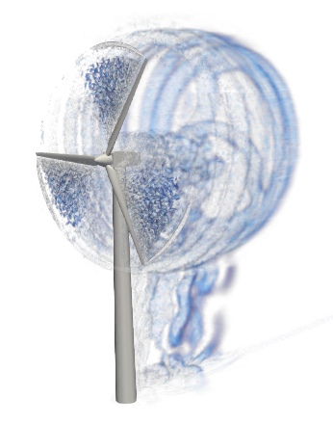
Reality: Meshing time for complex applications remains a significant bottleneck!
Many applications of interest contain complex geometries
low-Mach fluids users interested in high-quality simulation results tend towards hexahedral-based topologies (if possible)
However, if a scheme is “design-order” accurate, any topology may suffice as it is simply a matter of mesh size and efficiency – not unlike the active discussion on low- vs higher-order
Sometimes, the penetration of a low-Mach fluids physics addition in common analysis is high as the meshing can be prohibitively complex
UUR Example: Vestas V27 225 kw hybrid low-order hex/tet/pyr/wedge
Very complex world – stair-stepped!

Slide 23
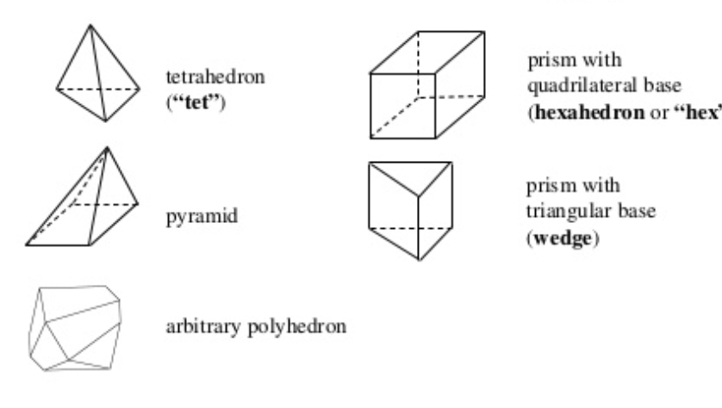
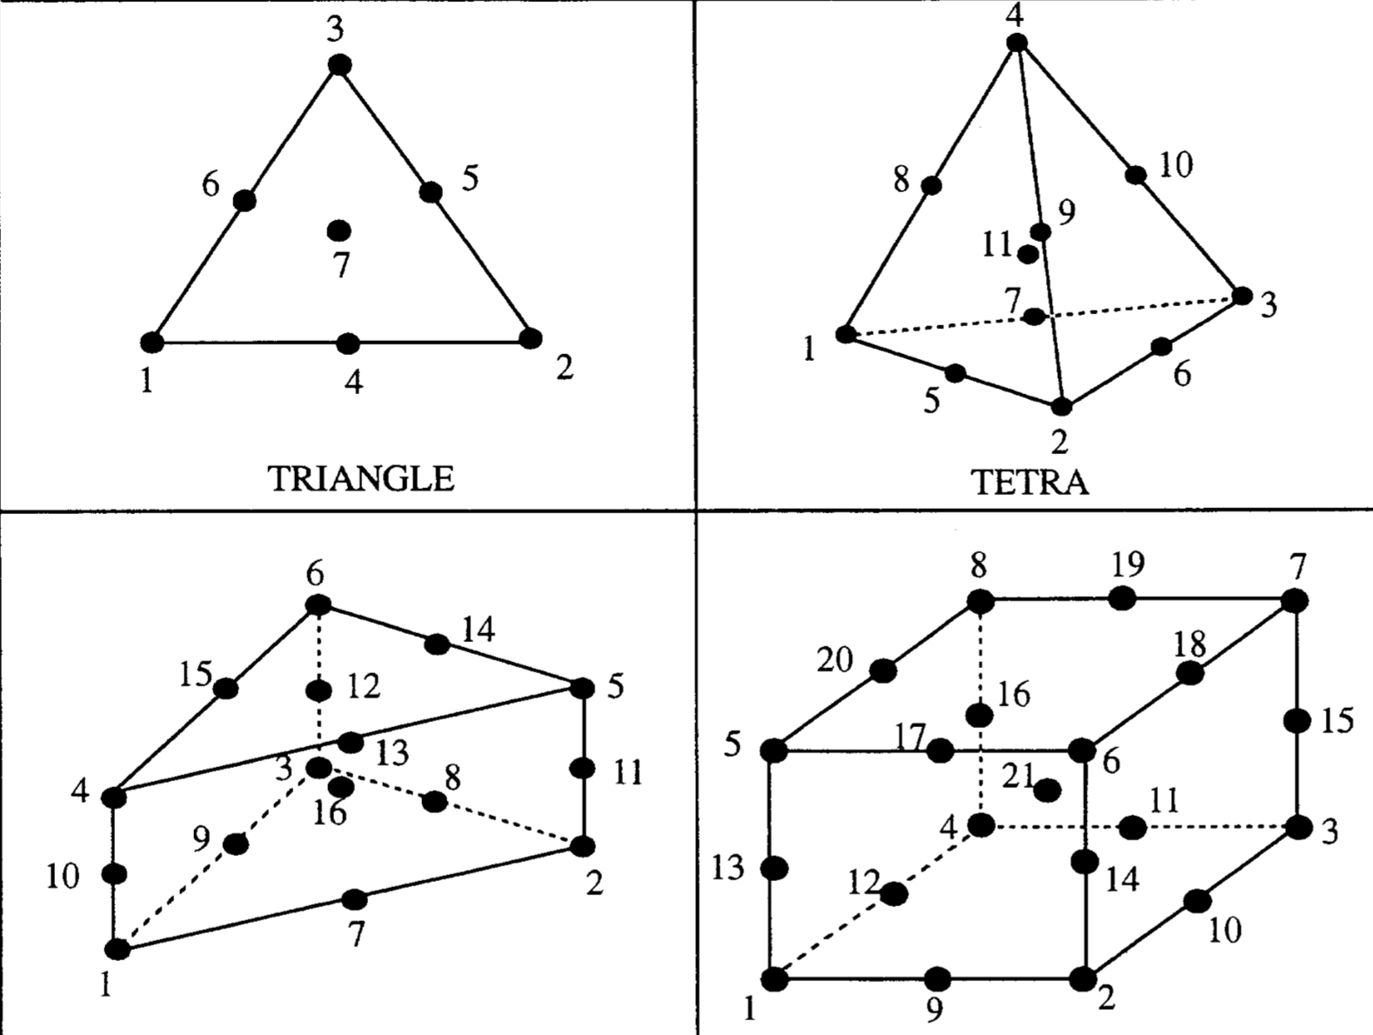
Examples of Various Topologies
Hex8
Tet4
Pyramid5
Wedge6
Arbitrary
Higher-order promoted elements (Hex27, Tet10, Wedge16, Hex64, etc.)

Slide 24
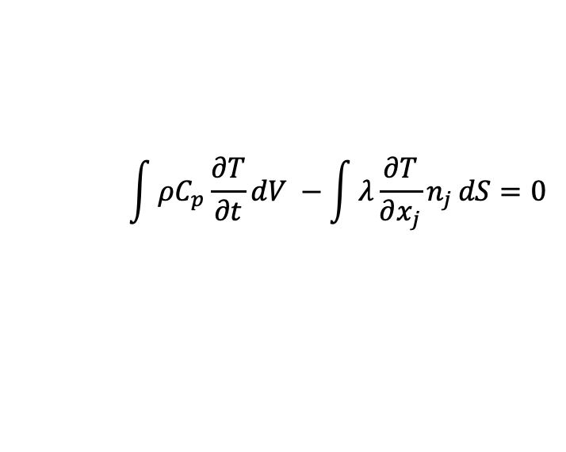
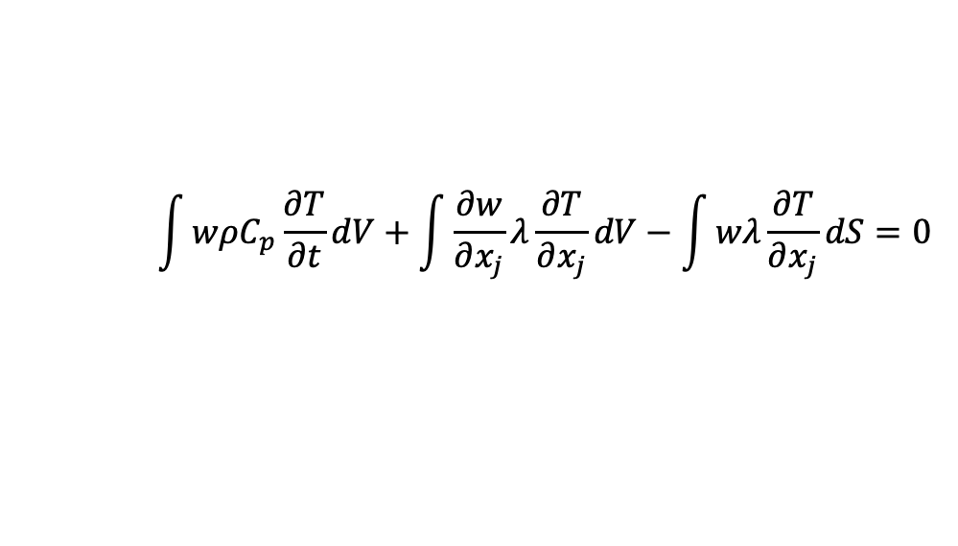
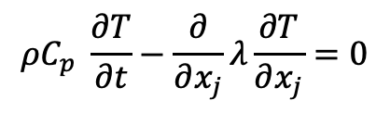
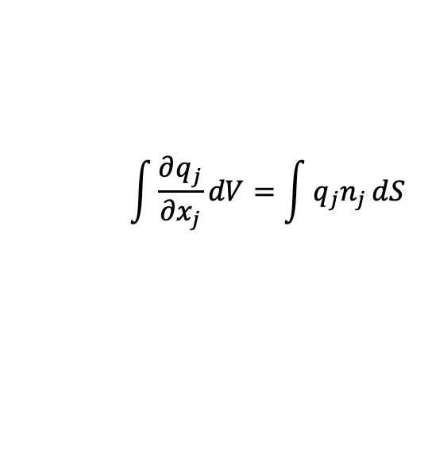
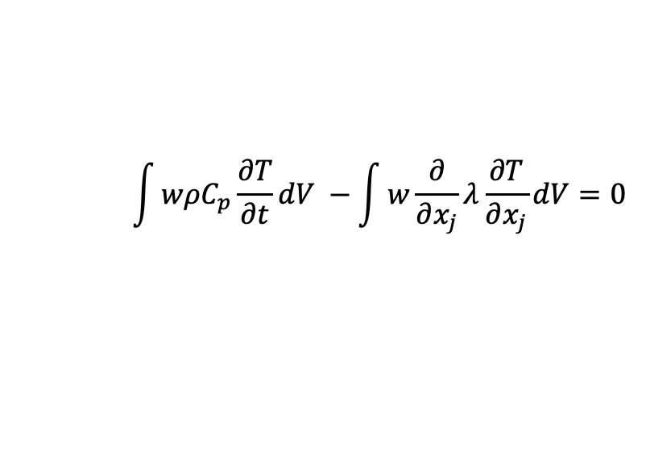
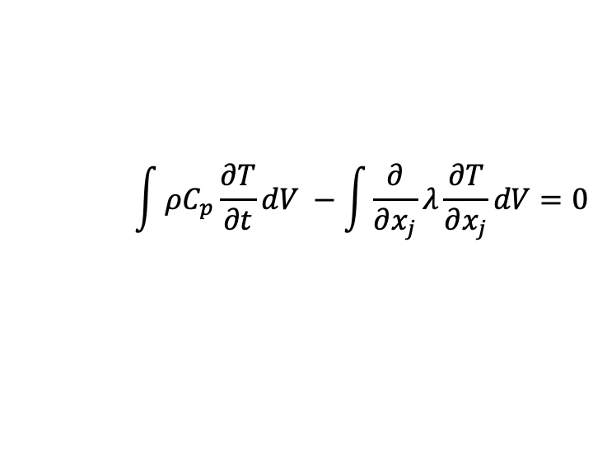
Fundamentals of Discretization (Review)
Given a partial differential equation (PDE) and associated volumetric form:
Applying Gauss Divergence provides the standard finite volume form:
We can also multiple PDE by an arbitrary test function, w, and integrate over a volume,
$$ρC_{p} \frac{∂T}{∂t}−\frac{∂}{∂x_{j}}λ\frac{∂T}{∂x_{j}}=0$$
$$\int{ρC_{p}\frac{∂T}{∂t}dV −\int{\frac{∂}{∂x_{j}}λ\frac{∂T}{∂x_{j}}}dV=0}$$
$$\int{\frac{∂q_{j}}{∂x_{j}}dV=\int{q_{j}n_{j}}dS}$$
$$\int{ρC_{p}\frac{∂T}{∂t}dV −\int{λ\frac{∂T}{∂x_{j}}n_{j}}dS=0}$$
Next, integrate by parts and apply
Gauss-Divergence. Note, that test function must be differentiable – shown here, at least once..
$$\int{wρC_{p}\frac{∂T}{∂t}dV −\int{w\frac{∂}{∂x_{j}}λ\frac{∂T}{∂x_{j}}}dV=0}$$
$$\int{wρC_{p}\frac{∂T}{∂t}dV+\int{\frac{∂w}{∂x_{j}}λ\frac{∂T}{∂x_{j}}}dV−\int{wλ\frac{∂T}{∂x_{j}}}dS=0}$$
Sometimes, one notes T as T^{h} - the trial space on given mesh size, h

Slide 25
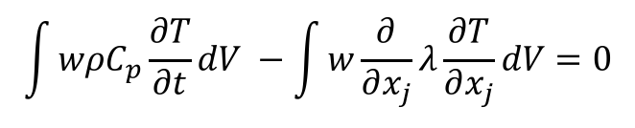
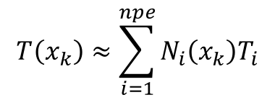
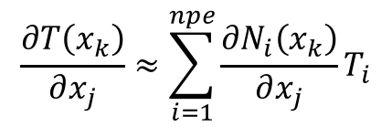
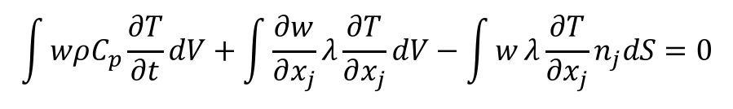
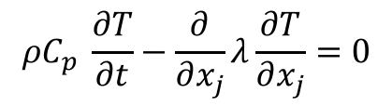
The Finite Element Method (FEM)
Consider the example in which the finite element method (FEM) is employed
Define an underlying nodal basis with the element:
Gaussian Quadrature is used
using a -1:1 range, +/- sqrt(3)/3
Consider a simple heat conduction model PDE,
Integrate using a test function,
Integration-by-parts (with G-D) provides:
Iterate element quadrature points
Note that N can be arbitrary in order (shown here for a linear)
$$T\left(x_{k}\right)≈\sum_{i=1}^{npe}{N_{i}\left(x_{k}\right)T_{i}}$$
$$\frac{∂T\left(x_{k}\right)}{∂x_{j}}≈\sum_{i=1}^{npe}{{\frac{∂N_{i}\left(x_{k}\right)}{∂x_{j}}T}_{i}}$$
$$ρC_{p} \frac{∂T}{∂t}−\frac{∂}{∂x_{j}}λ\frac{∂T}{∂x_{j}}=0$$
$$\int{wρC_{p}\frac{∂T}{∂t}dV −\int{w\frac{∂}{∂x_{j}}λ\frac{∂T}{∂x_{j}}}dV=0}$$
$$\int{wρC_{p}\frac{∂T}{∂t}dV+\int{\frac{∂w}{∂x_{j}}λ\frac{∂T}{∂x_{j}}}dV−\int{w}λ\frac{∂T}{∂x_{j}}n_{j}dS=0}$$

Slide 26
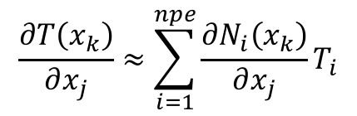
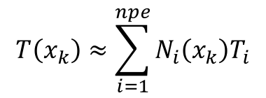
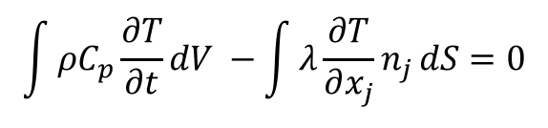
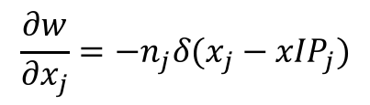
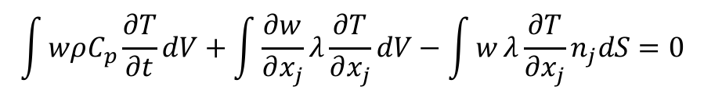
The Hybrid Control-Volume Finite Element Method (CVFEM)
A combination between a vertex-centered finite volume and FEM is the method known as Control Volume Finite Element
A dual mesh is constructed to obtain flux and volume quadrature locations
As with FEM, a basis is defined:
$$T\left(x_{k}\right)≈\sum_{i=1}^{npe}{N_{i}\left(x_{k}\right)T_{i}}$$
$$\frac{∂T\left(x_{k}\right)}{∂x_{j}}≈\sum_{i=1}^{npe}{{\frac{∂N_{i}\left(x_{k}\right)}{∂x_{j}}T}_{i}}$$
Integration-by-parts over test function w:
However, define a test function, w, as a piece-wise constant function (Heaviside) to be 1 inside the dual volume and 0 outside. Gradient is a Dirac-delta function:
Leading to:
$$\int{wρC_{p}\frac{∂T}{∂t}dV+\int{\frac{∂w}{∂x_{j}}λ\frac{∂T}{∂x_{j}}}dV−\int{w}λ\frac{∂T}{∂x_{j}}n_{j}dS=0}$$
$$\frac{∂w}{∂x_{j}}=−n_{j}δ(x_{j}−{xIP}_{j})$$
$$\int{ρC_{p}\frac{∂T}{∂t}dV −\int{λ\frac{∂T}{∂x_{j}}n_{j}}dS=0}$$
Dual-volume definition

Slide 27
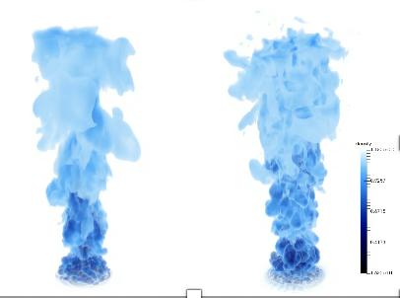
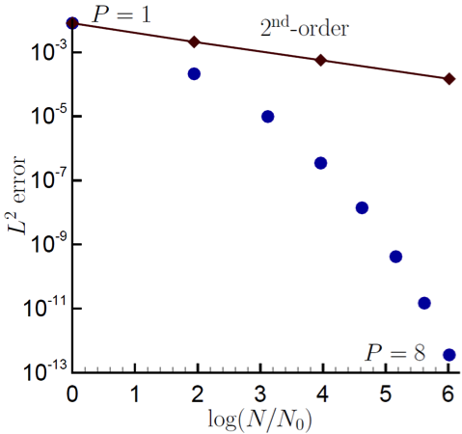
Control-Volume Finite Element Method Attributes
The CVFEM method, therefore, is a finite volume scheme that is locally conservative, i.e., momentum leaving one dual volume face enters the adjacent dual volume
However, the diffusion operator, like its FEM counterpart is absent of any error due to non-orthogonality
Suffers on high-aspect ratio meshes in presence of high gradients: sqrt(3)
Since the test-function, w, is different from the underlying basis representation, this method can be considered a Petrov-Galerkin method
The method can also be promoted in polynomial space (first fluids: Domino, 2014)
P=1 (left) and P=4 (right)
Helium plume (VR-density)
Spectral convergence
Dual-volume for promoted quad4

Slide 28
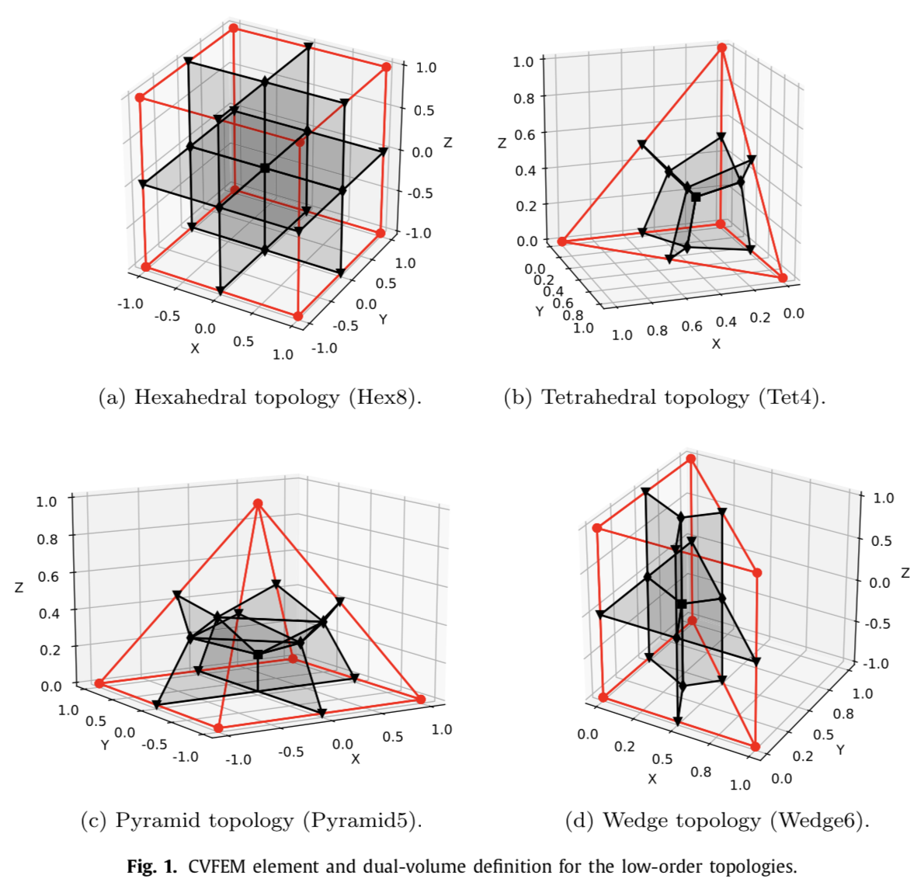
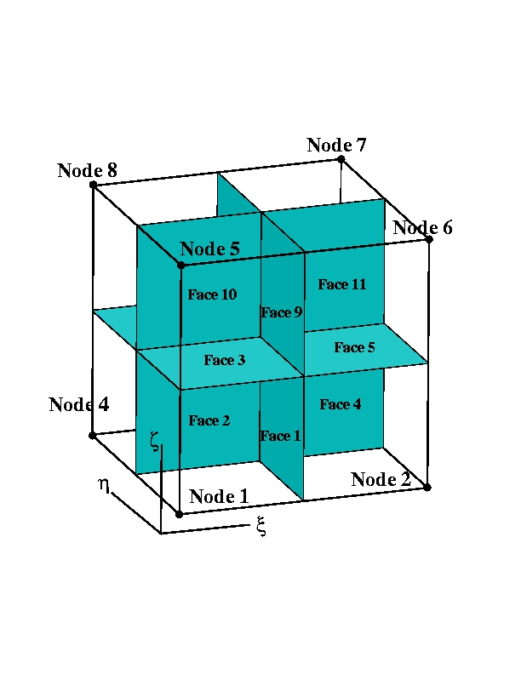
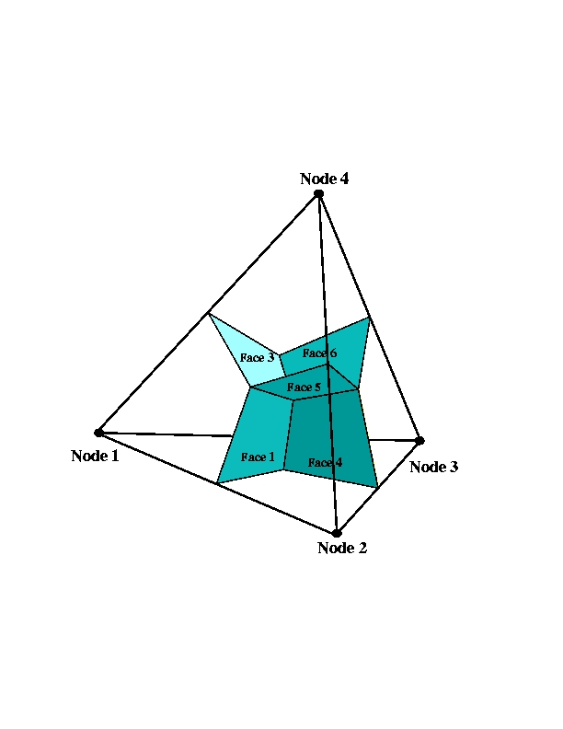
Dual Volume Definitions for Hybrid Meshes
Domino, et. al, “An assessment of atypical mesh topologies for low-Mach large-eddy simulation” 2019

Slide 29
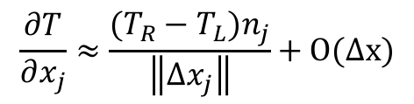
Equal Order Interpolation Edge-Based Vertex-Centered (EBVC) Finite Volume
All primitives are collocated at the vertices of the elements with equal-order interpolation
A dual mesh is constructed to obtain flux and volume quadrature locations
Classic two-state, “L” and “R” approach provides spatially second-order accuracy
Surface quadrature point (area summed to edge)
Volume quadrature point (sub-vol summed to node)
Same grad-op as CC:
Iterate nodes for volume contributions
Iterate edges for surface flux contribution
$$\frac{∂T}{∂x_{j}}≈\frac{(T_{R}−T_{L})n_{j}}{\left\|{Δx}_{j}\right\|}+O(∆x)$$
T_{L}
n_{j}
T_{R}
Dual-volume definition
Edge-based stencil

Slide 30
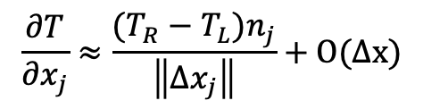
Equal Order Interpolation Edge-Based Vertex-Centered (EBVC) Finite Volume
All primitives are collocated at the vertices of the elements with equal-order interpolation
A dual mesh is constructed to obtain flux and volume quadrature locations
Classic two-state, “L” and “R” approach provides spatially second-order accuracy
Surface quadrature point (area summed to edge)
Volume quadrature point (sub-vol summed to node)
Same grad-op as CC:
Iterate nodes for volume contributions
Iterate edges for surface flux contribution
$$\frac{∂T}{∂x_{j}}≈\frac{(T_{R}−T_{L})n_{j}}{\left\|{Δx}_{j}\right\|}+O(∆x)$$
T_{L}
n_{j}
T_{R}
Dual-volume definition
Edge-based stencil

Slide 31
Equal Order Interpolation Edge-Based Vertex-Centered (EBVC) Finite Volume
All primitives are collocated at the vertices of the elements with equal-order interpolation
A dual mesh is constructed to obtain flux and volume quadrature locations
Classic two-state, “L” and “R” approach provides spatially second-order accuracy
Surface quadrature point (area summed to edge)
Volume quadrature point (sub-vol summed to node)
Same grad-op as CC:
Iterate nodes for volume contributions
Iterate edges for surface flux contribution
Dual nodal volume
$$\frac{∂T}{∂x_{j}}≈\frac{(T_{R}−T_{L})n_{j}}{\left\|{Δx}_{j}\right\|}+O(∆x)$$
Area vector
T_{L}
n_{j}
T_{R}
Dual-volume definition
Edge-based stencil

Slide 32
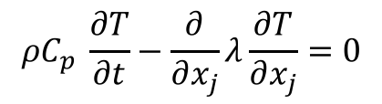
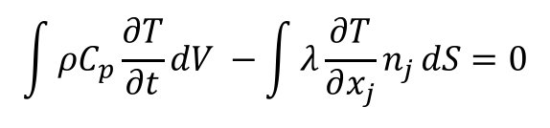
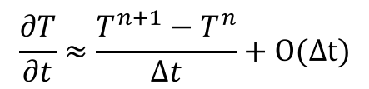
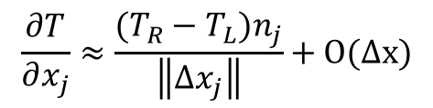
Equal-Order Interpolation Cell-Centered (CC) Finite Volume
All primitives are collocated at the cell-center of the element with equal-order interpolation
Classic two-state, “L” and “R” approach provides spatially second-order accuracy
Consider a simple heat conduction model PDE,
Integrate over a control volume and use Gauss-Divergence,
Iterate element cell-centers for volume contributions (time/source)
Iterate element faces for surface flux contribution
Surface
quadrature point
$$ρC_{p} \frac{∂T}{∂t}−\frac{∂}{∂x_{j}}λ\frac{∂T}{∂x_{j}}=0$$
T_{L}
T_{R}
$$\int{ρC_{p}\frac{∂T}{∂t}dV −\int{λ\frac{∂T}{∂x_{j}}n_{j}}dS=0}$$
n_{j}
$$\frac{∂T}{∂x_{j}}≈\frac{(T_{R}−T_{L})n_{j}}{\left\|{Δx}_{j}\right\|}+O(∆x)$$
with:
$$\frac{∂T}{∂t}≈\frac{T^{n+1}−T^{n}}{Δt}+O(∆t)$$

Slide 33
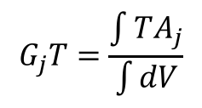
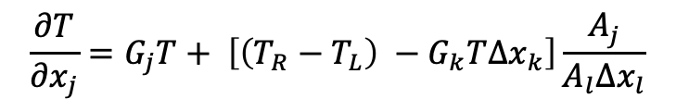
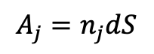
Typical Failings for Two-State Discretization Methods
With two points, only a linear basis can be used.
Therefore, unstructured CC and EBVC are limited to second-order spatial accuracy
Non-orthogonality is problematic for gradient-operator
Above, G_{j}T is a projected nodal gradient at the cell-center, or vertex center:
Non-orthogonality is simply defined as the mis-alignment of the distance vector between the two ”L” and “R” states and the surface normal
Both edge- and cell centered-based schemes show degraded accuracy on typical production meshes
Several non-orthogonality approaches are available, for the best source, see Jasak
Jasak, “Error analysis and error estimation for the finite volume method with applications to fluid flow”, Imperial College Dissertation, 1996
One Significant Advantage: Monotonicity preserving on high-aspect ratio meshes…
$$\frac{∂T}{∂x_{j}}=G_{j}T+ \left[\left(T_{R}−T_{L}\right) −G_{k}T∆x_{k}\right]\frac{A_{j}}{A_{l}∆x_{l}}$$
Δx_{j}
n_{j}
With area vector defined by:
$$A_{j}=n_{j}dS$$
$$G_{j}T=\frac{\int{TA_{j}}}{\int{dV}}$$

Slide 34
Classic Staggered Finite Volume
Stencil for CC-quantities
Stencil for x-velocity
Stencil for y-velocity
Velocity degree-of-freedom is staggered relative to pressure and other primitives, e.g., enthalpy, mixture fraction, etc.
P_{N}
P_{S}

Slide 35
Attributes of a Staggered Scheme
By design, non-orthogonality is absent, however, complex geometry will be stair-stepped
From a fluids perspective, the operators are ideal, i.e., pressure gradient for momentum is compact, e.g., (P_{E} – P_{W})Δx⁻¹
As will be seen in future lecture topics, the skew-adjoint nature of the Divergence operator, D, and Gradient operator, G, allows for a Laplace operator, L = DG
Can be extended to higher-order
Frequently, meshing complex geometries can be extremely difficult (consider our V27 example)

Slide 36
An Informal Survey….
Cell-Centered: (Sometimes generalized Polyhedra)
Ansys Fluent, OpenFOAM (FireFOAM, NavyFOAM), CD-Adapco (Star-CCM), Soleil-X (Stanford)
EBVC: (Most typical in the acoustically compressible space)
SU2, FUN3D, CHAD, Nalu-Wind (production), Nalu (option to explore discretizations)
CVFEM
Fluent (originally!), CFX-TASC-FLOW, Sierra Fuego (SNL), Nalu
FEM
FIDAP, COMSOL, EDDY (NASA), AcuSim, PHASTA
Staggered
Arches (Utah)

Slide 37
An Informal Survey….
Cell-Centered: (Sometimes generalized Polyhedra)
Ansys Fluent, OpenFOAM (FireFOAM, NavyFOAM), CD-Adapco (Star-CCM), Soleil-X (Stanforf)
EBVC: (Most typical in the acoustically compressible space)
SU2, FUN3D, CHAD, Nalu-Wind (production), Nalu (option to explore discretizations)
CVFEM
Fluent (originally!), CFX-TASC-FLOW, Sierra Fuego (SNL), Nalu
FEM
FIDAP, COMSOL, EDDY (NASA), AcuSim, PHASTA
Staggered
Arches (Utah)
Common Water-Cooler CFD Arguments:
Structured vs. Un-structured
FEM vs. Finite Volume
Node-centered vs. Cell-centered
Monolithic vs. Operator Split
Compressible vs. (acoustically) Incompressible
Explicit vs. Implicit

Slide 38

An Informal Survey….
Cell-Centered: (Sometimes generalized Polyhedra)
Ansys Fluent, OpenFOAM (FireFOAM, NavyFOAM), CD-Adapco (Star-CCM), Soleil-X (Stanforf)
EBVC: (Most typical in the acoustically compressible space)
SU2, FUN3D, CHAD, Nalu-Wind (production), Nalu (option to explore discretizations)
CVFEM
Fluent (originally!), CFX-TASC-FLOW, Sierra Fuego (SNL), Nalu
FEM
FIDAP, COMSOL, EDDY (NASA), AcuSim, PHASTA
Staggered
Arches (Utah)
Common Water-Cooler CFD Arguments:
Structured vs. Un-structured
FEM and Finite Volume
Node-centered vs. Cell-centered
Monolithic and Operator Split
Compressible vs. (acoustically) Incompressible
Explicit and Implicit

Slide 39


Hybrid Meshes, Even for LES!
Hybrid mesh study based on Ham and Iaccarino, CTR Annual Brief, 2006, found that simulations were extremely sensitive to mesh topology
Non-symmetric time mean flow found for cell-centered; better for the CTR node-centered formulation
Native CVFEM and EBVC are both symmetric in mean quantities
T
B
Domino, et. al, “The suitability of hybrid meshes for low-Mach large-eddy simulation” Stanford CTR Summer Program, 2018

Slide 40



Recent Generalized Unstructured Findings
Domino, et. al, “An assessment of atypical mesh topologies for low-Mach large-eddy simulation” 2019

Slide 41
A Note on Parallelism… Vertex-based
Sierra Toolkit/Standard Ownership rules: Mesh object (nodes, edges, faces, elements) owned by lower-rank. For example:
P0 locally owns E1 and nodes 1, 2, 4, and 5
P1 locally owns E2, E3, and E4 and nodes 3, 6, 7, 8, and 9
P0 and P1 share nodes 2, 4, and 5
Desired Control-Volume Finite Element (CVFEM) Operation:
“nodal volume” assemble for node 5 via iteration of each 1cmx1cm element. Desired nodal volume for node 5 = 1 cm² exactly the same on both parallel ranks
Options:
1. Iterate over locally owned elements and locally accumulate nodal volume field followed by a parallel sum and copy owned to shared.
2. Ghost element E2, E3, and E4 to P0 and E1 to P1 (along with coordinates) and iterate locally owned and ghosted elements. Locally accumulate nodal volume field followed by a copy owned to shared.
P0
1
2
3
face 1
E1
E2
4
edge 1
5
edge 2
6
E3
E4
7
8
P1
9

Slide 42
A Note on Parallelism… Vertex-based
Sierra Toolkit/Standard Ownership rules: Mesh object (nodes, edges, faces, elements) owned by lower-rank. For example:
P0 locally owns E1 and nodes 1, 2, 4, and 5
P1 locally owns E2, E3, and E4 and nodes 3, 6, 7, 8, and 9
P0 and P1 share nodes 2, 4, and 5
Desired Control-Volume Finite Element (CVFEM) Operation:
“nodal volume” assemble for node 5 via iteration of each 1cmx1cm element. Desired nodal volume for node 5 = 1 cm² exactly the same on both parallel ranks
Options:
1. Iterate over locally owned elements and locally accumulate nodal volume field followed by a parallel sum and copy owned to shared.
2. Ghost element E2, E3, and E4 to P0 and E1 to P1 (along with coordinates) and iterate locally owned and ghosted elements. Locally accumulate nodal volume field followed by a copy owned to shared.
P0
1
2
3
face 1
E1
E2
¼
¼
4
edge 1
5
edge 2
6
¼
¼
E3
E4
7
8
P1
9

Slide 43
A Note on Parallelism… Aura-based; View from P0
P0
1
2
3
E1
E2
4
5
6
E3
E4
7
8
P1
9
Ghost P1 -> P0

Slide 44
A Note on Parallelism… Aura-based; View from P1
P0
1
2
3
E1
E2
4
5
6
E3
E4
7
8
P1
9
Ghost P0 -> P1

Slide 45
Common low-Mach Discretization Approaches: Conclusions
Two-state methods, e.g., cell-centered and EBVC are attractive due to simplicity, however, suffer from non-orthogonality issues in the diffusion operator
Generally, CC or EBVC is 2x faster on a given mesh size
Less accurate/stable on generalized unstructured mesh topologies
Better diffusion operator on high-aspect ratio meshes
Simple, single topology (virtual-, or full-edge)
FEM provides a machinery to provide accurate discretizations on non-ideal meshes, however, the same diffusion operator suffers on high-aspect ratio meshes
CVFEM is a hybrid method that contains the likeable attributes of both FV and FEM (same high-aspect ratio diffusion operator finding)
Staggered arrangement is well suited for a class of fluid mechanics applications where low-order or simple geometries are found
Examples for time/source/advection and diffusion provided for EBVC, CVFEM, and FEM
Recall that Nalu iterates over locally-owned mesh objects as apposed to local+ghosted
This is a choice; however, the STK infrastructure allows for both approaches
Test yourself on a dual nodal volume assembly?

Slide 46
Stanford ME469: Common low-Mach Discretization Approaches: EBVC
Stefan P. Domino
Computational Thermal and Fluid Mechanics
Sandia National Laboratories SAND2018-4536 PE

Slide 47
Review of Discretization Options
Let’s revisit out curved, heart domain
DOFs at cell-centered: Stencil is based on a element:face:element; Tet4 elem ~6xNumNodes
DOFs at vertices of elements, or “nodes”, element:node (CVFEM, FEM), edge:node (EBVC)

Slide 48
Equal Order Interpolation Edge-Based Vertex-Centered (EBVC) Finite Volume
All primitives are collocated at the vertices of the elements with equal-order interpolation
A dual mesh is constructed to obtain flux and volume quadrature locations
Classic two-state, “L” and “R” approach provides spatially second-order accuracy
Surface quadrature point (area summed to edge)
Volume quadrature point (sub-vol summed to node)
Same grad-op as CC:
Iterate nodes for volume contributions
Iterate edges for surface flux contribution
Dual nodal volume
$$\frac{∂T}{∂x_{j}}≈\frac{(T_{R}−T_{L})n_{j}}{\left\|{Δx}_{j}\right\|}+O(∆x)$$
Area vector
T_{L}
n_{j}
T_{R}
Dual-volume definition
Edge-based stencil

Slide 49
Example of a Quadratic Basis Function
1. 3. 2
3
Quadratic Linear
Two-dimensional promotion

Slide 50




Running a CFD Simulation: Essential Attributes
Mesh
Input File(s)
- inflow_boundary_condition: bc_left
target_name: Inflow
inflow_user_data:
velocity: [1.0,0.0]
mixture_fraction: 0.0
Hex8
Tet4
launch remotely
launch locally
output.log
output.e.32.*
output.rst.32.*
Remote Viz
>scp output.e.32.* /to/my/local/disk

Slide 51





Simple One-D MMS Example; General Form
Consider a simple diffusion equation:
with a presumed, or manufactured solution:
$$\frac{d^{2}φ}{{dx}^{2}}=0$$
$$\frac{∂^{2}φ^{mms}}{{∂x}^{2}}{=S}^{mms}=2$$
Gauss-Divergence
$$\int{\frac{d^{2}φ}{{dx}^{2}}dV}=\int{S^{mms}dV}$$
$$\int{\frac{dφ}{dx}dS}=\int{S^{mms}dV}$$
Discrete flux-based form:
$$\sum_{scsIP}{\frac{dφ}{dx}A_{scsIP}=\sum_{scvIP}{S^{mms}V_{scvIP}}}$$
With error:

Slide 52




Simple One-D MMS Example; Edge-based Assemble of Diffusion
We will use a linear basis and solve this system over a small patch of linear bar elements
node = 0
1
Δx = 1
2
3
x
x
x
Recall, simplified equation with RHS from source term already provided
Iterate elements with a simple left-hand side rule: += L and -=R
(note implicit conservation statement)
$$\sum_{scsIP}{{\frac{dφ}{dx}}_{scsIP}=\sum_{scvIP}{S^{mms}\frac{∆x}{2}}}$$
0
1
x
$${lhs}_{0}+=\frac{φ_{1}−φ_{0}}{∆x}$$
Edge 1
$${\frac{dφ}{dx}}_{scsIP} =\frac{φ_{1}−φ_{0}}{∆x}$$
$${lhs}_{1}−=\frac{φ_{1}−φ_{0}}{∆x}$$

Slide 53



Simple One-D MMS Example; Edge-based Assemble of Diffusion
We will use a linear basis and solve this system over a small patch of linear bar elements
node = 0
1
Δx = 1
2
3
x
x
x
Recall, simplified equation with RHS from source term already provided
Iterate elements with a simple left-hand side rule: += L and -=R
(note implicit conservation statement)
$$\sum_{scsIP}{{\frac{dφ}{dx}}_{scsIP}=\sum_{scvIP}{S^{mms}\frac{∆x}{2}}}$$
1
2
x
$${lhs}_{1}+=\frac{φ_{2}−φ_{1}}{∆x}$$
Edge 2
$${\frac{dφ}{dx}}_{scsIP} =\frac{φ_{2}−φ_{1}}{∆x}$$
$${lhs}_{2}−=\frac{φ_{2}−φ_{1}}{∆x}$$

Slide 54



Simple One-D MMS Example; Edge-based Assemble of Diffusion
We will use a linear basis and solve this system over a small patch of linear bar elements
node = 0
1
Δx = 1
2
3
x
x
x
Recall, simplified equation with RHS from source term already provided
Iterate elements with a simple left-hand side rule: += L and -=R
(note implicit conservation statement)
$$\sum_{scsIP}{{\frac{dφ}{dx}}_{scsIP}=\sum_{scvIP}{S^{mms}\frac{∆x}{2}}}$$
2
3
x
$${lhs}_{2}+=\frac{φ_{3}−φ_{2}}{∆x}$$
Edge 3
$${\frac{dφ}{dx}}_{scsIP} =\frac{φ_{3}−φ_{2}}{∆x}$$
$${lhs}_{3}−=\frac{φ_{3}−φ_{2}}{∆x}$$

Slide 55








Simple One-D MMS Example; Collect all of the lhs entries
Fully assembled
matrix
$${lhs}_{0}+=\frac{φ_{1}−φ_{0}}{∆x}$$
$${lhs}_{1}−=\frac{φ_{1}−φ_{0}}{∆x}$$
Fully assembled
system
$${lhs}_{1}+=\frac{φ_{2}−φ_{1}}{∆x}$$
$${lhs}_{2}−=\frac{φ_{2}−φ_{1}}{∆x}$$
Correct for BCs
Correct for BCs:
$${lhs}_{2}+=\frac{φ_{3}−φ_{2}}{∆x}$$
$${lhs}_{3}−=\frac{φ_{3}−φ_{2}}{∆x}$$
Solution is exact….. Linear basis exactly captures a quadratic solution

Slide 56



Model Passive Scalar Transport; Heaviside Test Function
Time/Src/Advection/Diffusion equation for scalar φ
Recall, the CVFEM and EBVC test function meets our requirement in that it is differentiable once
This definition also allows us to view such methods as Petrov-Galerkin schemes

Slide 57

Model Passive Scalar Transport: Fully Implicit
Time/Src/Advection/Diffusion equation for scalar φ

Slide 58

Model Passive Scalar Transport: Fully Implicit
Time/Src/Advection/Diffusion equation for scalar φ

Slide 59
Model Passive Scalar Transport: Coupling
Our fully coupled implicit system consists of: continuity, momentum, and mixture fraction
{
do while (!converged) {
}
For a given
time step:
Left-hand-side (LHS) or Jacobian is simplified for the passive scalar system
AΔx = b – Ax*=-res

Slide 60
Model Passive Scalar Transport: Coupling
Our fully coupled implicit system consists of: continuity, momentum, and mixture fraction; shown below in “residual form”
{
do while (!converged) {
}
X
X
X
X
For a given
time step:
X
X
X
X
X
X
X
X
X
X
X
X
X
X
X
X
X
Left-hand-side (LHS) or Jacobian is simplified for the passive scalar system
AΔx = b – Ax*=-res ~ MΔx

Slide 61
Deep Dive on EBVC
Recall, EBVC is a discretization scheme that:
Iterates over locally-owned nodes for Time/Source/etc. (volumetric-based terms)
Iterates over locally-owned edges for Advection/Diffusion/etc. (integrated by parts terms)
Below is the patch of elements connected to node 2 (a global matrix row number)
Area vector at the edge and dual volume at the node require the node:element connectivity whose quantities are determined in a pre-processing step
8
5
6
n5
e3
n1
n2
n3
1
2
3
e1
e2
e4
n4
7
4
Sample patch of elements
Note: No expectation of nodal ordering..

Slide 62


Deep Dive on EBVC: Node and Edge-loops
Recall, EBVC is a discretization scheme that:
Iterates over locally-owned nodes for Time/Source/etc. (volumetric-based terms)
Iterates over locally-owned edges for Advection/Diffusion/etc. (integrated by parts terms)
n5
n2
e3
n1
n2
n3
e1
e2
n1 (L)
n2 (R)
n2 (L)
n3 (R)
e4
e1
e2
n4

Slide 63

Deep Dive on EBVC: Implicit Time Discretization
Let us define a general implicit time integrator that is A-stable
For y’ = k y ; y(0) = 1; y(t) = e^{kt} solution approaches zero as time increases for k < 0
Backward Euler (two state) and is first-order accurate (A-stable)
BDF2 (three state) is second-order accurate (A-stable)
This term is assembled over a nodal iteration
For uniform time steps:
γ₁ = 3/2
γ₂ = -2
γ₃ = 1/2
n2

Slide 64

Deep Dive on EBVC: Implicit Time Discretization (Code)
https://github.com/NaluCFD/Nalu/blob/master/src/ScalarMassBDF2NodeSuppAlg.C
Note the implicit term

Slide 65
Deep Dive on EBVC: Source Term Discretization
Source terms for the edge-based scheme are also assembled over a nodal loop
Note that in this scheme, we are using single point quadrature, i.e., the function is evaluated at a single point
p = 2N -1
Where N is the number of integration points and p is the polynomial order
For a linear basis, using one-point quadrature is design-order
n2

Slide 66

Deep Dive on EBVC: Source Term Discretization (Code)
https://github.com/NaluCFD/Nalu/blob/master/src/user_functions/VariableDensityMixFracSrcNodeSuppAlg.C

Slide 67
Deep Dive on EBVC: Advection Discretization (no stabilization)
For advection, we have transformed the volume integral to a surface integration
Therefore, a patch of edges are required for the full assembly at node 2
Recall, that the mass flow rate at an integration point is prescribed
Moreover, since the integration point is at the edge mid-point, φ_{ip} = (φ^{R} + φ^{L})/2
This is a central- or Galerkin-based advection operator; shown in conservative form
n5
n1 (L)
n2 (R)
n2 (L)
n3 (R)
e3
e1
e2
n1
n2
n3
Note: Advection term must be in divergence form….
e1
e2
e4
n4

Slide 68
Deep Dive on EBVC: Advection Discretization (Code)
https://github.com/NaluCFD/Nalu/blob/master/src/AssembleScalarEdgeSolverAlgorithm.C
This routine includes advection and diffusion

Slide 69





Upwind Operators; Scalar Z
Upwind advection operators can provide diagonal dominance (at the cost of accuracy)
However, upwind operators, even if higher-order, are numerically diffuse
Higher-order upwind (second-order in space) can be obtained on an unstructured mesh by use of projected nodal gradients and extrapolation:
j-1
Z_{j-1/2}
j
Z_{j+1/2}
j+1
$$Z_{j+1/2}=\left\{\begin{aligned}{ Z}_{j};u>0 \\ Z_{j+1};u<0\end{aligned}\right.$$
“as the wind blows”
$$G_{x}Z_{j}=\frac{Z_{j+1}−Z_{j−1}}{2∆x}$$
$$G_{x}Z_{j−1}=\frac{Z_{j}−Z_{j−2}}{2∆x}$$
$$Z_{j+1/2}=∝\left(Z_{j}+G_{x}Z_{j}\frac{∆x}{2}\right)+\left(1−∝\right)\left[\frac{1}{2}\left(Z_{j}+Z_{j+1}\right)\right]$$
α is a blending
parameter
for u>0
$$Z_{j−1/2}=∝\left(Z_{j−1}+G_{x}Z_{j−1}\frac{∆x}{2}\right)+\left(1−∝\right)\left[\frac{1}{2}\left(Z_{j}+Z_{j−1}\right)\right]$$

Slide 70





Pseudo Higher-order Upwind
Blending extrapolated upwind with central (Z_{L}+Z_{R})/2 provides:
Slope limiting required when gradients are not smooth (Berger et al, 2005, 43rd AIAA)
$$Z_{j+1/2}=∝\left(Z_{j}+G_{x}Z_{j}\frac{∆x}{2}\right)+\left(1−∝\right)\left[\frac{1}{2}\left(Z_{j}+Z_{j+1}\right)\right]$$
for u>0
$$Z_{j−1/2}=∝\left(Z_{j−1}+G_{x}Z_{j−1}\frac{∆x}{2}\right)+\left(1−∝\right)\left[\frac{1}{2}\left(Z_{j}+Z_{j−1}\right)\right]$$
$$Z_{j+1/2}=∝\left(Z_{j+1}+G_{x}Z_{j+1}\frac{∆x}{2}\right)+\left(1−∝\right)\left[\frac{1}{2}\left(Z_{j}+Z_{j+1}\right)\right]$$
for u<0
$$Z_{j−1/2}=∝\left(Z_{j}+G_{x}Z_{j}\frac{∆x}{2}\right)+\left(1−∝\right)\left[\frac{1}{2}\left(Z_{j}+Z_{j−1}\right)\right]$$
$$\dot{m}$$
j-2 | j-1 | j | j+1 | j+2 | α
1/4 | -5/4 | +3/4 | +1/4 | 0 | 1 | >0
0 | -1/4 | -3/4 | +5/4 | -1/4 | 1 | >0
+1/6 | -6/6 | +3/6 | +2/6 | 0 | 1/2 | <0
0 | -2/6 | -3/6 | +6/6 | -1/6 | 1/2 | <0
Resulting
1-D Stencil

Slide 71

Deep Dive on EBVC: Diffusion Discretization
For diffusion, we have transformed the volume integral to a surface integration
Therefore, a patch of edges are required for the full assembly at node 2
n5
n1 (L)
n2 (R)
n2 (L)
n3 (R)
e3
e1
e2
n1
n2
n3
e1
e2
e4
n4

Slide 72


Deep Dive on EBVC: Diffusion Discretization
The edge-based diffusion operator is a bit more complex in that we are computing a gradient at the integration point while using two nodes, the left and right
In many practical meshes, the distance vector between the edges (dx_{j}) and the edge area vector will not be perfectly orthogonal
This non-orthogonality causes inaccuracy when using a simplified approach
The non-orthogonality approach of Jasek (Ph.D. Imperial College) is a standard cell-centered approach that has been adopted for edge-based schemes
CC and EBVC are each two-state schemes and share non-orthogonality issues
n2 (L)
n3 (R)
e2

Slide 73

Deep Dive on EBVC: Diffusion Discretization (code)
https://github.com/NaluCFD/Nalu/blob/master/src/AssembleScalarEdgeDiffSolverAlgorithm.C

Slide 74

Deep Dive on Nodal Gradient Operator: An Alternative View
Recall, that the edge-based diffusion operator, and for some choices for the advection operator, a nodal gradient is required
What is a nodal gradient? As formerly described in the Computing Gradients lecture, in a cell-centered context we obtained this via a number of ways, e.g., Green-Gauss, Least Squares, etc.
Let’s take another view…
First, the gradient of a function (other than linear) is discontinuous, i.e., the value at a shared element face depends on which element is used to compute the gradient
Therefore, we can view the nodal gradient a continuous at the nodes and discontinuous within the elements
Let’s minimize this difference:
by solving:
Lumped-mass

Slide 75
Types of Boundary Conditions
Inflow: values are known and enforced via a Dirichelp
Open: pressure known: flow in or out of the domain; zero gradient for diffusion
Wall: values are known and enforced via a Dirichlet
Symmetry: Normal stress specified; tangential stress zero
Non-conformal: hybrid DG/CVFEM
“overset”: Constraint-based
See: https://nalu.readthedocs.io/en/latest/source/theory/boundaryConditions.html

Slide 76
Deep Dive on EBVC: Example Case
For a mid-term set of example cases, we have selected a flow past a two-dimensional cylinder at a Reynolds number of 150
Mesh and input files can be found in the Nalu/examples/street directory
Familiarize yourself with this physics set via literature surveys
As a starting place, see: https://en.wikipedia.org/wiki/Kármán_vortex_street
Also look at the Canvas Nalu lecture notes for a brief write-up
In this test case, we have added a passive scalar field whose inflow is zero and wall boundary condition unity. For your final project, feel free to modify inflow and wall parameters as you choose.
Note that this case uses a conformal hybrid mesh, or a mesh of disparate element topologies, Quad4 and Tri3

Slide 77

Deep Dive on EBVC: Example Viz (Passive Scalar)
Hybrid mesh (quad4/tri3)

Slide 78
Some Interesting Configurations: Flow Parameters
- inflow_boundary_condition: bc_left
target_name: Inflow
inflow_user_data:
velocity: [1.0,0.0]
mixture_fraction: 0.0
Controls the flow Reynolds number (along with density and viscosity)
- symmetry_boundary_condition: bc_top_bottom
target_name: Sides
symmetry_user_data:
“slip”, or zero tangential velocity at top and bottom; change to a wall for a duct entrance example
- wall_boundary_condition: bc_cylinder
target_name: Cylinder
wall_user_data:
velocity: [0.0,0.0]
mixture_fraction: 1.0
Fixed velocity; change to rotating via user function?
﻿Time_Integrators:
- StandardTimeIntegrator:
name: ti_1
start_time: 0
termination_step_count: 2000
time_step: 1.0e-3
time_stepping_type: adaptive
time_step_count: 0
second_order_accuracy: yes
second_order_accuracy: yes/no

Slide 79

Some Interesting Configurations
Upwind using projected nodal gradients is limited
- limiter:
velocity: yes
mixture_fraction: no
- laminar_schmidt:
mixture_fraction: 0.9
- peclet_function_form:
velocity: tanh
mixture_fraction: tanh
- peclet_function_tanh_transition:
velocity: 2.0
mixture_fraction: 1000.0
- peclet_function_tanh_width:
velocity: 4.0
mixture_fraction: 100.0

Slide 80
Common low-Mach Discretization Approaches: Conclusions
Two-state methods, e.g., cell-centered and EBVC are attractive due to simplicity, however, suffer from non-orthogonality issues in the diffusion operator
Generally, CC or EBVC is 2x faster on a given mesh size
Less accurate/stable on generalized unstructured mesh topologies
Better diffusion operator on high-aspect ratio meshes

Slide 81
Stanford ME469: Common low-Mach Discretization Approaches: CVFEM/FEM
Stefan P. Domino
Computational Thermal and Fluid Mechanics
Sandia National Laboratories SAND2018-4536 PE

Slide 82
Deep Dive on CVFEM
Recall, CVFEM is a discretization scheme that:
Iterates over locally-owned elements for Time/Source/etc. (volumetric-based terms)
Iterates over locally-owned elements for Advection/Diffusion/etc. (integrated by parts terms)
Below is the patch of elements connected to node 2 (a global matrix row number)
8
5
6
Note: Time and source terms can also be evaluated at nodes without loss of accuracy
1
2
3
7
4
Sample patch of elements

Slide 83

Deep Dive on CVFEM: Element-loops
For each element, recall that a dual volume has been constructed
Volume-based contributions are evaluated at the subcontrol volume integration points (diamonds)
Surface-based contributions are evaluated at the subcontrol surface integration points (triangles)
We define an isoparametric element than ranges from -1:1 in the ξ− (x-direction) and η− (y-direction) direction
Basis Functions for a Quad4
For example, the isoparametric coordinate for ip 1 is (0.0, -0.5)

Slide 84


Deep Dive on CVFEM: Implicit Time Discretization
Backward Euler (two state) and is first-order accurate (A-stable)
BDF2 (three state) is second-order accurate (A-stable)
This term is assembled over an element iteration and drives a consistent mass matrix with a full node:element:node connectivity
For uniform time steps:
γ₁ = 3/2
γ₂ = -2
γ₃ = 1/2

Slide 85
Deep Dive on CVFEM: Implicit Time Discretization
Backward Euler (two state) and is first-order accurate (A-stable)
BDF2 (three state) is second-order accurate (A-stable)
This term is assembled over an element iteration and drives a consistent mass matrix with a full node:element:node connectivity
For uniform time steps:
γ₁ = 3/2
γ₂ = -2
γ₃ = 1/2

Slide 86
Deep Dive on CVFEM: Implicit Time Discretization (Code)
https://github.com/NaluCFD/Nalu/blob/master/src/kernel/ScalarMassElemKernel.C
Convecting Taylor Vortex analytical solution; error computed at 1 second

Slide 87

Deep Dive on CVFEM: Source Term Discretization
Source terms for CVFEM are also assembled over an element or nodal loop
In some cases, the source term is complex, i.e., includes gradients, which drives either a nodal assembly of these quantities to the nodes or local evaluation

Slide 88

Deep Dive on CVFEM: Source Term Discretization (Code)
https://github.com/NaluCFD/Nalu/blob/master/src/user_functions/SteadyThermal3dContactSrcElemKernel.C

Slide 89
Deep Dive on CVFEM: Advection Discretization (no stabilization)
For advection, we have transformed the volume integral to a surface integration
Therefore, a patch of elements are required for the full assembly at node 2
Recall, that the mass flow rate at an integration point is prescribed
Integration points can also be shifted from the subcontrol surface to the edge mid-poiny (while still using the integration point area vector)
This is a central- or Galerkin-based advection operator
Note:
Common to integrate-by-parts, however, not required
Advection term need not be in divergence form (non-conserved form is suitable)

Slide 90




Deep Dive on CVFEM: Advection Discretization Non-Conserved Form
The advection term can be integrated by parts, or not; moreover, the PDE can drive a non-conservative equation form
IBP – or not…
This is now a choice
Non-conserved form, unlike cell-centered FV, poses no complexity

Slide 91
Deep Dive on CVFEM: Advection Discretization (Code)
https://github.com/NaluCFD/Nalu/blob/master/src/kernel/ScalarAdvDiffElemKernel.C
This routine includes advection and diffusion
Recall that integration point value is provided by nodal loop over the underlying nodal basis for this element
Also note that this routine is valid for all types of supported elements – both low- and higher-order
Basis Functions for a Quad4

Slide 92



Deep Dive on CVFEM: Diffusion Discretization
For diffusion, we have transformed the volume integral to a surface integration
Therefore, a patch of elements are required for the full assembly at node 2
Note that the CVFEM approach is absent any non-orthogonality corrections;
However, high aspect ratio elements are now challenging…

Slide 93

Deep Dive on CVFEM: Diffusion Discretization (code)
https://github.com/NaluCFD/Nalu/blob/master/src/kernel/ScalarAdvDiffElemKernel.C
Manufactured solution for Laplace system on TQuad4

Slide 94
Deep Dive on FEM
Recall, FEM is a discretization scheme that:
Iterates over locally-owned elements for Time/Source/etc (volumetric-based terms)
Iterates over locally-owned elements for Advection/Diffusion/etc. (integrated by parts terms)
Below is the patch of elements connected to node 2 (a global matrix row number)
8
5
6
Note: Single integration point location for all terms
1
2
3
7
4
Sample patch of elements

Slide 95
Deep Dive on FEM: Element-loops
For each element, we have a set of integration or quadrature points (no dual-notion)
We define an isoparametric element than ranges from -1:1 in the ξ− (x-direction) and η− (y-direction) direction
Gaussian quadrature on a -1:1 range is defined, +/- sqrt(3)/3
Basis Functions for a Quad4
5 [4] (-1,1)
6 [3] (1,1)
4
3
1
2
1
2
2 [1] (-1,-1)
3 [2] (1,-1)

Slide 96

Deep Dive on FEM: Implicit Time Discretization
Backward Euler (two state) and is first-order accurate (A-stable)
BDF2 (three state) is second-order accurate (A-stable)
This term is assembled over an element iteration and drives a consistent mass matrix with a full node:element:node connectivity
For uniform time steps:
γ₁ = 3/2
γ₂ = -2
γ₃ = 1/2
5 [4] (-1,1)
6 [3] (1,1)
4
3
1
2
1
2
2 [1] (-1,-1)
3 [2] (1,-1)

Slide 97
Deep Dive on FEM: Source Term Discretization
Source terms for FEM are assembled over an element loop
In some cases, the source term is complex, i.e., includes gradients, which drives either a nodal assembly of these quantities to the nodes or local evaluation
5 [4] (-1,1)
6 [3] (1,1)
4
3
1
2
1
2
2 [1] (-1,-1)
3 [2] (1,-1)

Slide 98
Deep Dive on FEM: Advection Discretization
Advection terms for FEM are assembled over an element loop
The advection term can be integrated by parts, or not; moreover, the PDE can drive a non-conservative equation form
IBP – or not…
This is now a choice
5 [4] (-1,1)
6 [3] (1,1)
4
3
1
2
1
2
2 [1] (-1,-1)
3 [2] (1,-1)
Non-conserved form, like CVFEM, poses no complexity

Slide 99

Deep Dive on FEM: Diffusion Discretization
For diffusion, we will again use the nodal basis to support a diffusion operator
Integration-by-parts is desired to remove the second-derivative requirement that would not be possibly for a linear basis
5 [4] (-1,1)
6 [3] (1,1)
4
3
1
2
1
2
2 [1] (-1,-1)
3 [2] (1,-1)
Note that the FEM approach is absent any non-orthogonality corrections

Slide 100

Element Integration: Physical to Transformed Space
Let us define a linear basis over a representative two-dimensional quadrilateral with iso-parametric range of ξ: -1:+1 and η: -1:+1
Goal: Evaluate an integral:
Change of variables:
Transformation:
|J| is determinant of the transformation matrix
With weight w_{g}

Slide 101
Deep Dive on FEM: Discretization Kernels (Code)
Time
https://github.com/NaluCFD/Nalu/blob/master/src/kernel/ScalarMassFemKernel.C
Advection
https://github.com/NaluCFD/Nalu/blob/master/src/kernel/ScalarAdvFemKernel.C
Diffusion
https://github.com/NaluCFD/Nalu/blob/master/src/kernel/ScalarDiffFemKernel.C

Slide 102
Common low-Mach Discretization Approaches: Conclusions
FEM provides a machinery to provide accurate discretizations on non-ideal meshes, however, the same diffusion operator suffers on high-aspect ratio meshes
CVFEM is a hybrid method that contains the likeable attributes of both FV and FEM (same high-aspect ratio diffusion operator finding)

Slide 103
Stanford ME469: Common low-Mach Discretization Approaches: Comparisons
Stefan P. Domino
Computational Thermal and Fluid Mechanics
Sandia National Laboratories SAND2018-4536 PE

Slide 104

Philosophy: Bridges, not Walls
Me469 Tenant: Let’s work to understand how each method relate to one another
FVM
CVFEM
FD
GFEM

Slide 105


Laminar Backstep
Laminar back step (Re = 389 based on step height) comparing two code implementations for CVFEM (Sierra/Fuego and Sierra Aria), FEM (within Aria – here termed, “hybrid” FEM, or HFEM – essentially, the same low-Mach CVFEM approach with full integration-by-parts).
X-component of velocity
Vertical line represents one-D
line plot location

Slide 106


Laminar Jet
Y-component of velocity

Slide 107

Order-of-Accuracy
Difficult two dimensional variable density low-Mach flow using method of manufactured solutions; DOFS: u, v, p and Z; density = f(Z)
FEM
CVFEM

Slide 108


Isothermal Taylor-Vortex Decay
Exercising the low-and high-order (P=1 and P=2 CVFEM) along with EBVC with and without pseudo-higher-order upwind)
Domino, 2014 “A comparison between low-order and higher-order low-Mach discretization approaches”, Proceedings of CTR Summer Program.

Slide 109


Non-Conformal Laplace Verification

Slide 110
Hybrid Meshes, Even for LES!
Hybrid mesh study based on Ham and Iaccarino, CTR Annual Brief, 2006, found that simulations were extremely sensitive to mesh topology
Non-symmetric time mean flow found for cell-centered; better for the CTR node-centered formulation
Native CVFEM and EBVC are both symmetric in mean quantities
T
B
Domino, et. al, “The suitability of hybrid meshes for low-Mach large-eddy simulation” Stanford CTR Summer Program, 2018

Slide 111





5m JP-8 Pool Fire Validation
Novel participating media radiation solver verification (Tet4, Hex8, Hex27): EBVC and CVFEM, however, based on Streamwise Upwind Petrov Galerkin (SUPG), Burns, 1997
1.7m
${ s}_{j}^{k}\frac{∂I^{k}}{∂x_{j}}+\left(μ_{a}+μ_{s}\right)$ $I^{k}=\frac{μ_{a}σT^{4}}{π}$+ $\frac{μ_{s}G}{4π}$
$$\int{\tilde{w}\left(s_{j}^{k}\frac{∂I^{k}}{∂x_{j}}+\left(μ_{a}+μ_{s}\right) I^{k}−\left(\frac{μ_{a}σT^{4}}{π}\text{+} \frac{μ_{s}G}{4π}\right)\right)}dV=0$$
$$\int{s_{j}^{k}I^{k}n_{j}dS+\int{\left(\left(μ_{a}+μ_{s}\right) I^{k}−S\right)dV}}=\int{τs_{j}^{k}{R^{k}n}_{j}dS}$$
Domino et al. “Predicting large-scale pool fire dynamics using an unsteady flamelet- and large-eddy simulation-based model suite", Physics of Fluids, 2021 (Editor's pick: August 4, 2021).
Notes:
The former V&V method required experts choosing the appropriate LES models (Smagorinsky, Ksgs, and WALE). In most cases, no one (sadly) really evaluates this model-form error.
Choosing multiple models in a V&V credibility effort required coding of the said models, verification of the models, and maintenance, i.e., $$$$. Is there a better way to manage structural uncertainty for LES? Yes, my V&V project in partnership with Stanford is doing this..
Background: In LES, we desire to close the subgrid stress (SGS), or Tau_ij.
This SGS stress is a symmetric tensor that is positive-definite. As such, we can perform an eigenvalue decomposition. The eigenvectors provide an orthonormal basis while the eigenvalues represent the ”weight” towards the limiting types of turbulence: one-component (rods), two-component (pancakes) and three-component (isotropic and circular).
The triangle is a “barycentric triangle” that represents a linear mapping between the eigenvalues to a picture. The shaded triangle is a real simulation where we are probing a point in space and plotting the eigenvalue decomposition (open jet). Any viable model ever dreamed of must fit inside this triangle.
By perturbing the eignevalues and eigenvectors, we can evaluate uncertainty in the LES model. This is really powerful.

Slide 112
Model Passive Scalar Transport
Time/Src/Advection/Diffusion equation for scalar φ
Here, w is the weight function, or an arbitrary function that is differentiable - at least once
Any ideas why? What are the properties of the above PDE?
In this example, let density, velocity, and diffusive flux coefficient be prescribed
This equation, with a prescribed velocity, can be used to model trace species contaminant transport, smoke, etc.
The above equation is termed a weighted-residual statement of the original PDE
Thus far, it is exact

